Slide 1
Directed study review
Reading/listening: Heravi/Framing The Story
Make story outline & check the structure
Analyse examples in the genre you are using
Identify if they use a kabob or inverted pyramid.
Adjust your draft to follow the same structure.
Share it with me before the next class!

Slide 2
Classes will be 10-1 from next week

Slide 3

Editing for the web
Paul Bradshaw, Birmingham City University
MED7334 Narrative

Slide 4
What I’ll cover:
What qualities to edit for in an online story
Serving the user, not your ego (be literal, findable, usable)
How to add value: linking, embedding, illustrating

Slide 5
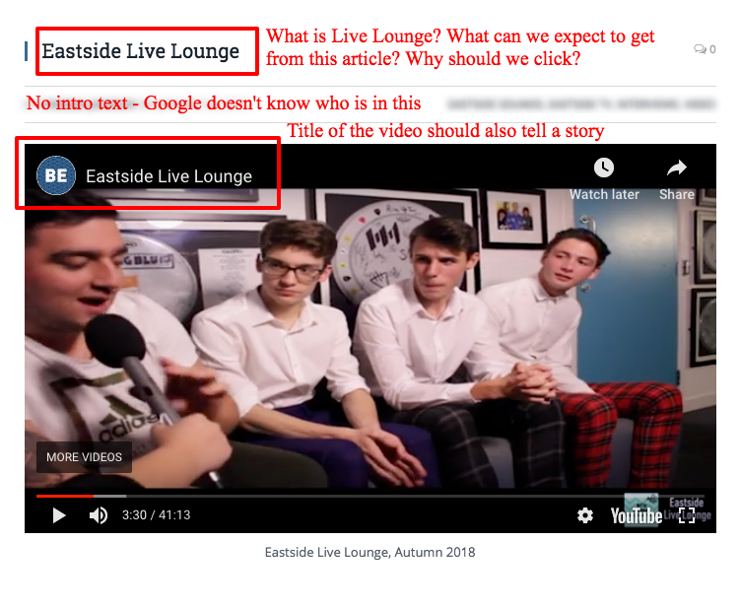
How not to do it...

Slide 6

BASIC principles
..

Slide 7
BASIC
principles
Brevity: keep pars short
Adaptability of medium & content
Scannability: subheads, timestamps
Interactivity: link, utility
Community/conversation: engage

Slide 8
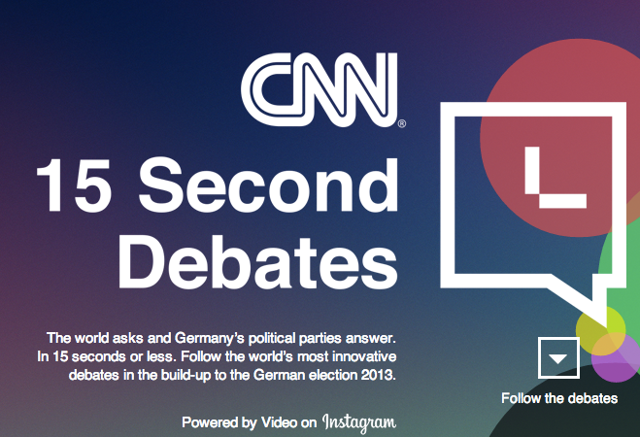
Brevity
Keep it simple, stupid.

Slide 9
People read… 25% slower
Source: Jakob Nielsen: http://bit.ly/G4auC

Slide 10
less than 28% of words
Jakob Nielsen: http://bit.ly/ZYni

Slide 11
Short paragraphs received twice as much attention as long.
Poynter EyeTrack study: http://eyetrack.poynter.org/previous.html

Slide 12
(I’ll say that again.)

Slide 13
Short paragraphs received twice as much attention as long.
Poynter EyeTrack study: http://eyetrack.poynter.org/previous.html

Slide 14
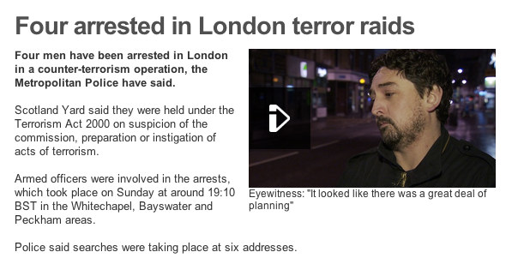
One. idea. per. par.

Slide 15
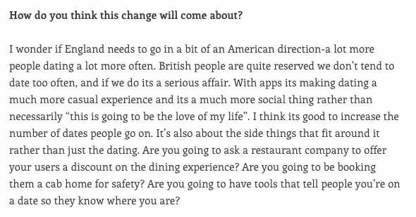
split your pars.

Slide 16
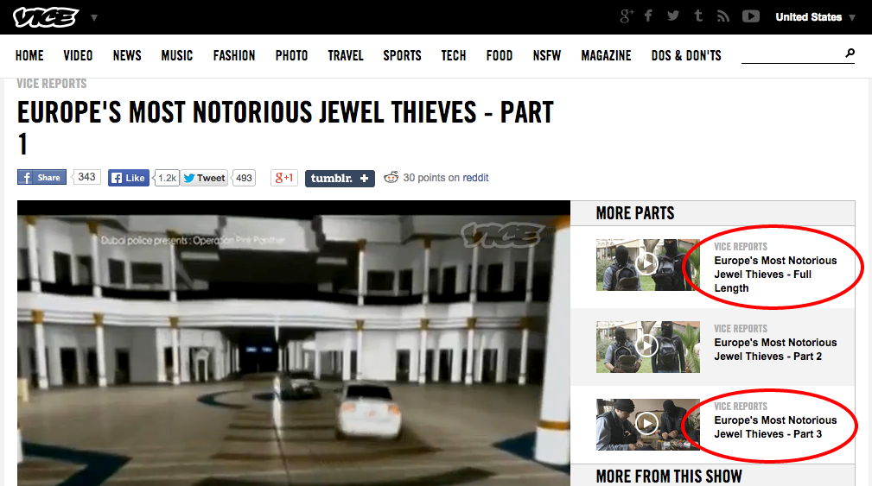
‘Chunking’: splitting a longer story into shorter parts

Slide 17
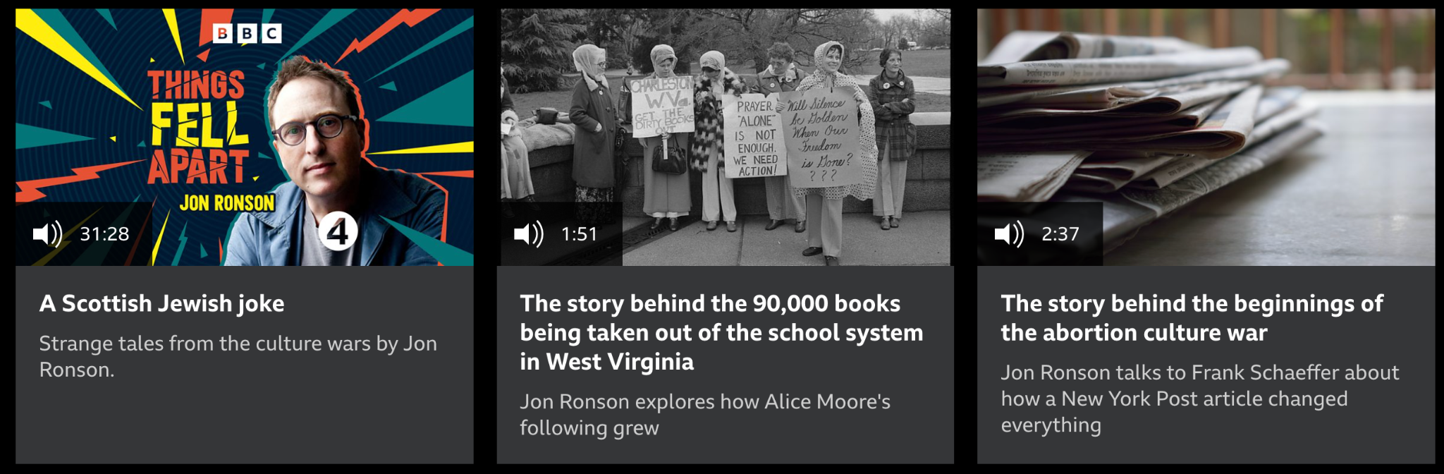
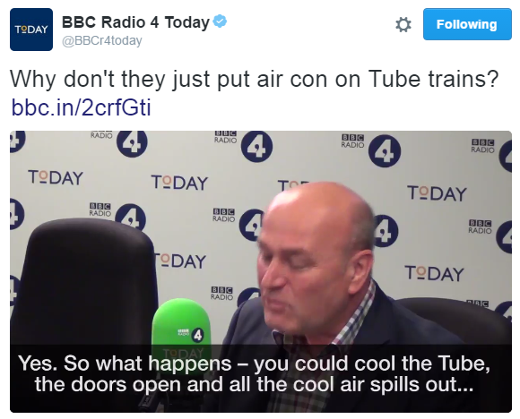
‘Clipping’: sections of a longer story that can work alone (edited)
https://www.bbc.co.uk/programmes/m0011cpr
https://twitter.com/bbcr4today/status/776144928296632323

Slide 18
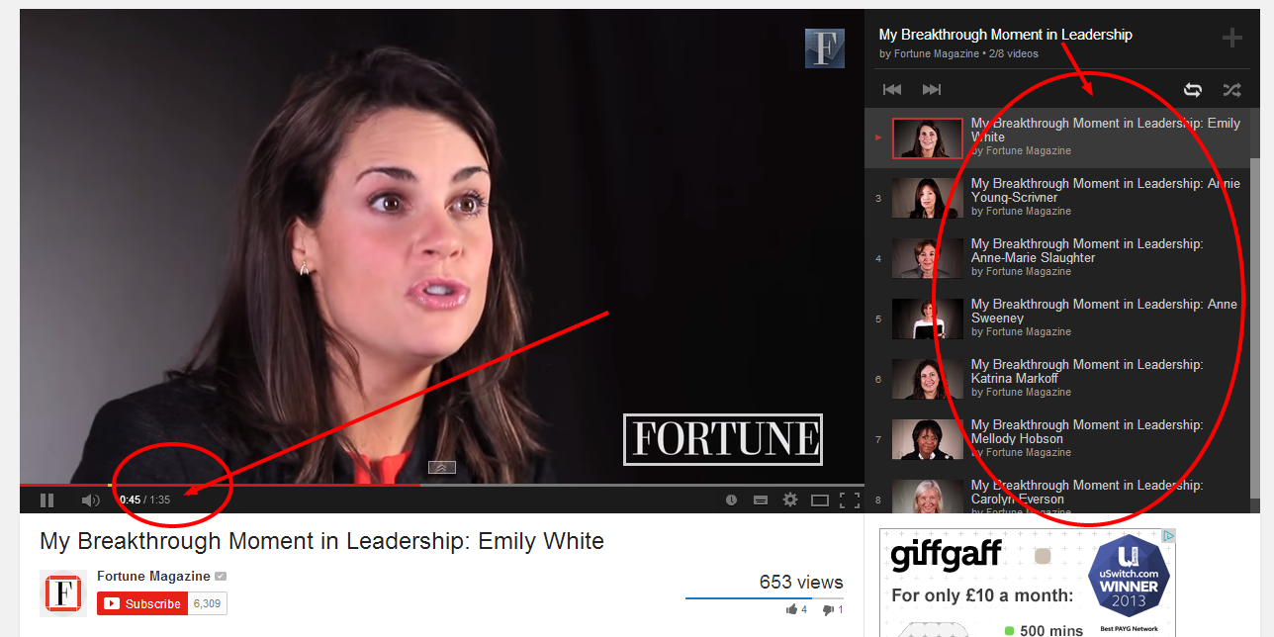
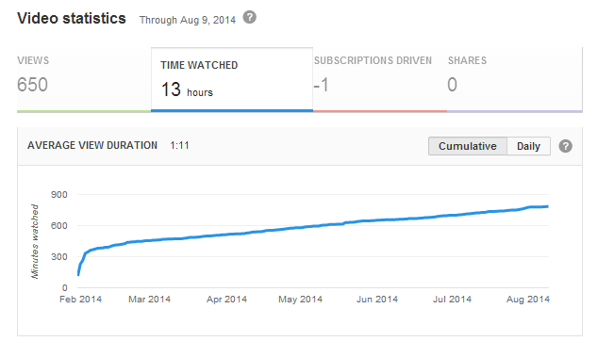
https://www.youtube.com/watch?v=fG6VP1n-A9c&list=PLS8YLn_6PU1mmR8NBsB_4FxUy2TyEdpIV&index=2

Slide 19
Consider clip formats that ‘sell’ brevity

Slide 20
“You only have 7 seconds to engage people: if you don’t, they will go elsewhere.”
Mukul Devichand, editor of BBC Trending
Hayward, David. Making great online video: Don’t imitate TV. https://medium.com/@david_hbm/making-great-online-video-don-t-imitate-tv-748e3dabfdfc

Slide 21
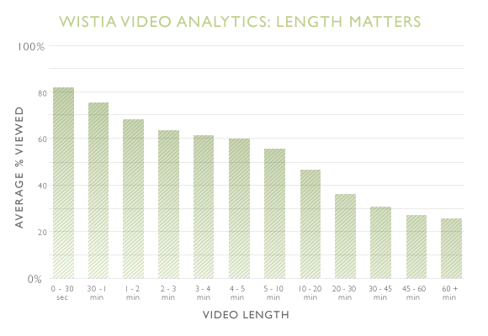
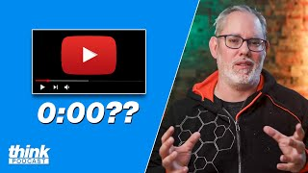
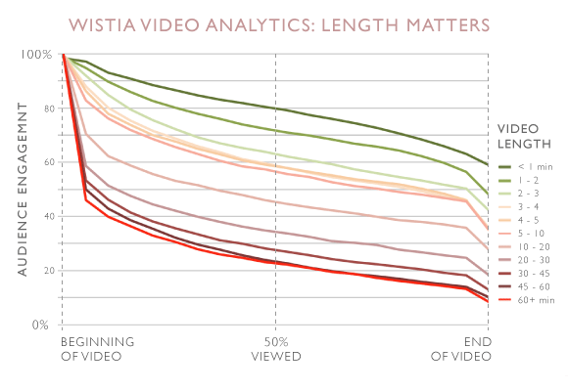
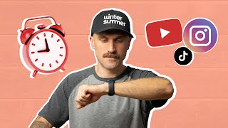
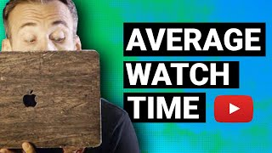
http://wistia.com/blog/does-length-matter-it-does-for-video-2k12-edition

Slide 22
Let’s start doing this.
Open the workshop on Moodle
Edit the story for brevity

Slide 24
Adaptability
Of you and the content

Slide 25
Are you adaptable?
Is the content?

Slide 26
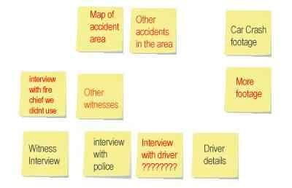
Can you adapt raw material to create more stories?
http://digidickinson.net/2007/03/12/moving-from-tv-to-online/

Slide 27
You will always be writing for the web
All media production involves writing for the web at some point:
video/audio will require you to write for YouTube, website, show notes, transcripts, blog posts etc.

Slide 28
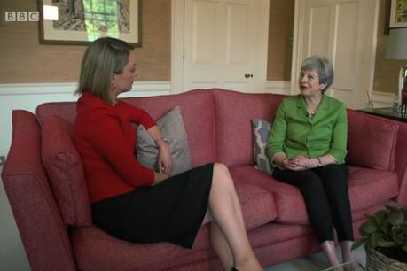
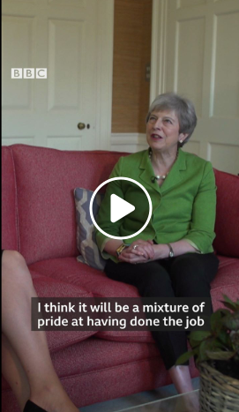
While the website version opens in the staircase, the Facebook version opts for the hand held, sofa opening scene.
"It was a deliberate attempt to make the video as accessible as possible," said Jonathan Paterson, editor, digital video, BBC News.
Granger, Journalism.co.uk, 2019
Can you adapt your video for vertical?

Slide 29
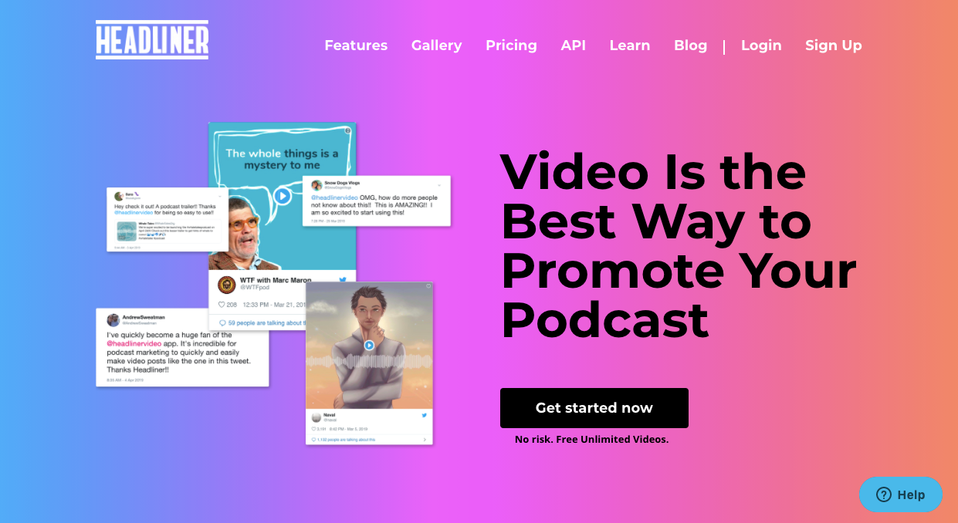
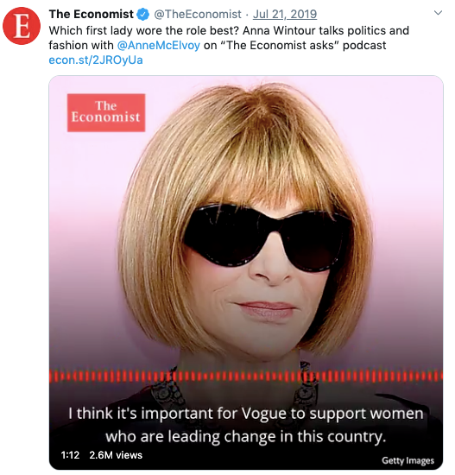
Can you adapt your audio
— for video?
headliner.app/
Economist audiogram
Earwolf audiogram

Slide 30
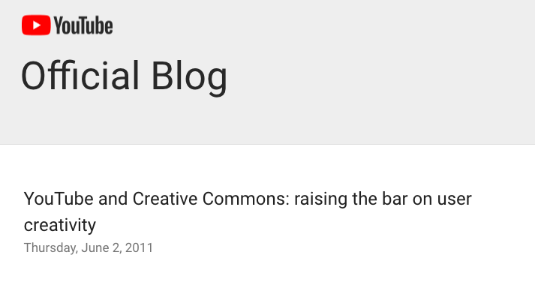
Can you make it easier for others to adapt your content?

Slide 31
Generate ideas for
4 other pieces of content
you could make from your interview

Slide 33
Scannability
Task-oriented users.

Slide 34
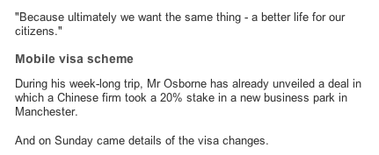
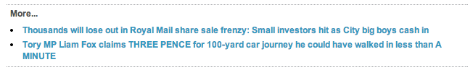
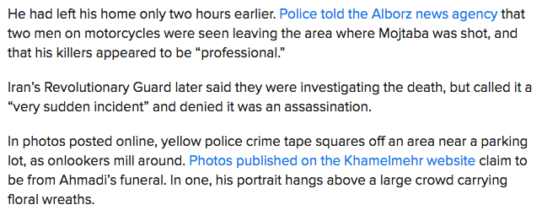

Slide 35
Elements of scannability
Headlines and subheadings
Bullet and numbered lists (see also)
Blockquotes
Links and bold text
A clear and simple intro
Images as ‘subheads’

Slide 36
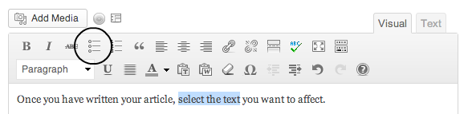
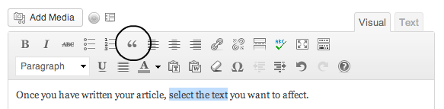

Slide 37
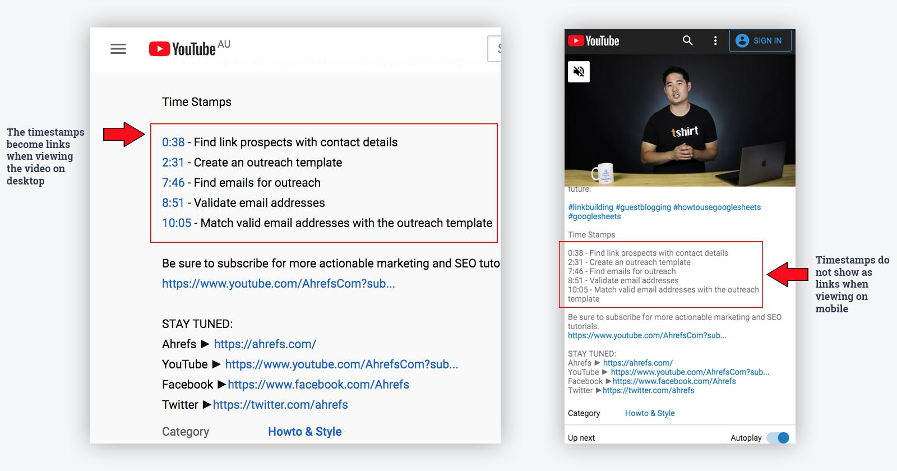
Scannability in video & audio: timestamps
Read more: How to Make the Most of Video Timestamp Results in Google Search

Slide 38
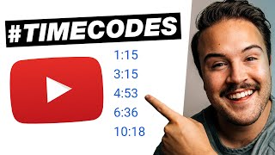
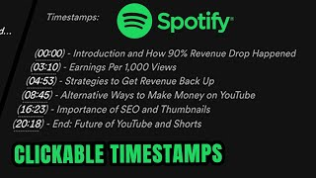
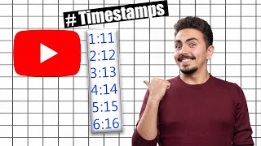


Slide 39
I created timestamps on my video, improving scannability and SEO (Bradshaw 2023, Clark 2020)
Bibliography entry:
Clark, Brodie. How to Make the Most of Video Timestamp Results in Google Search, Search Engine Journal, May 11 2020
How you might reference this:

Slide 40
Edit your story for scannability!

Slide 41
I edited my story for BASIC principles (Bradshaw 2023), splitting pars, adding subheadings and links.
Bibliography entry:
Bradshaw, Paul (2023) Online Journalism Handbook, Routledge
How you might reference this:

Slide 43
Interactivity
What might the user want to do?

Slide 44
Link

Slide 45
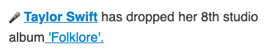
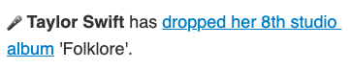
Think carefully about which words you link. What do you expect at each link above?

Slide 46
“Content with both a greater number of links and with shorter links yields better results in terms of levels of perception, comprehension and, above all, user behaviour.”
Arias-Robles (2017)

Slide 47
But you need to follow the link at the bottom of any slide to read more about it and get the full reference!
You could reference that

Slide 48
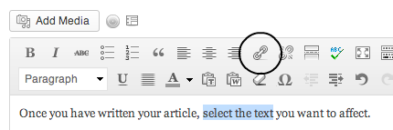
Link words or phrases
do not put URLs into stories

Slide 49
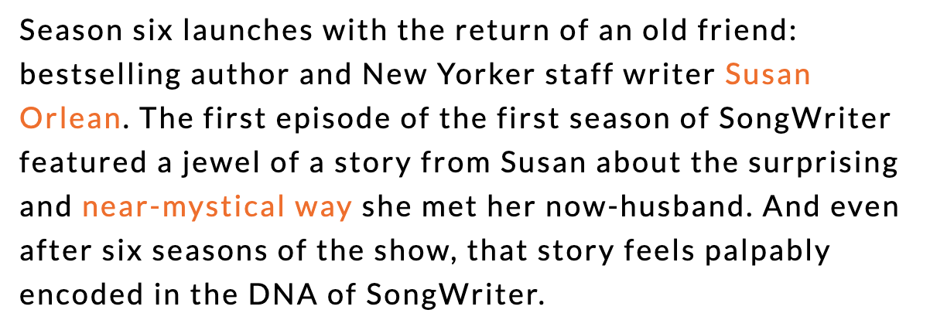
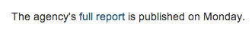
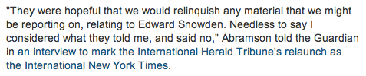
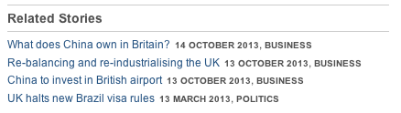
Link verbs like ‘said’ or ‘won’ to stories
Link nouns like ‘report’ or ‘data’ to documents
Link concepts and names to explainers & profiles
Songwriter podcast

Slide 50
Embed

Slide 51
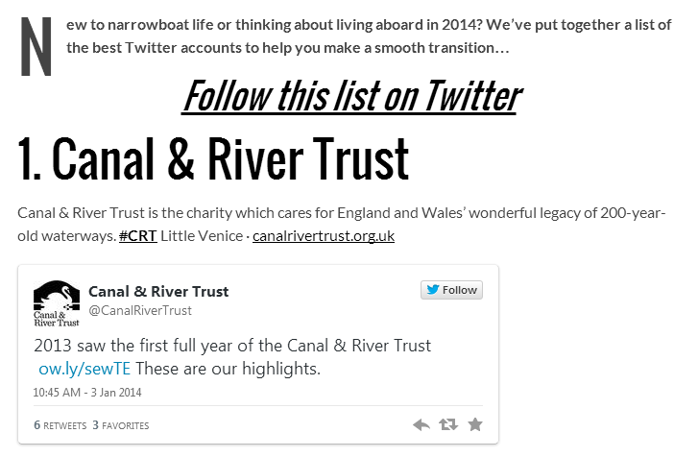
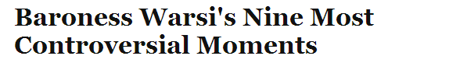
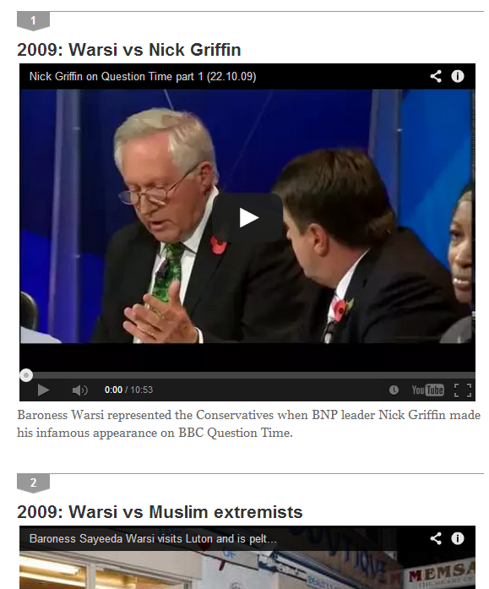

Slide 52
Embedding video/audio: 4 roles
Illustrate the story (like pictures) e.g. raw footage
Add to the story (like links) e.g. explainers, full interviews
Distil the story (like headlines) e.g. social video
Tell the story (standalone)

Slide 53
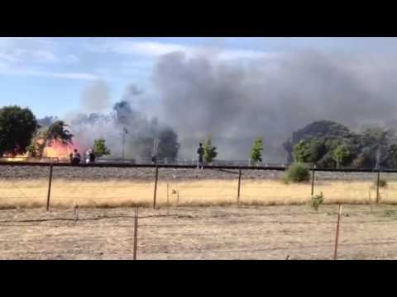
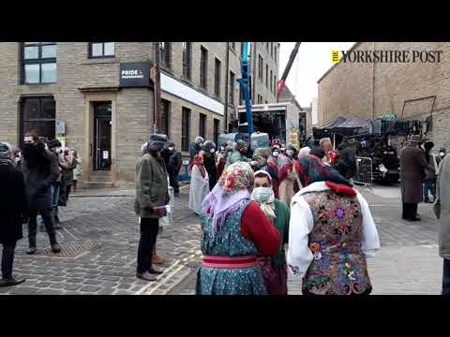
Illustrating the story:
http://www.poynter.org/how-tos/digital-strategies/266699/tips-for-broadcast-journalists-when-sharing-breaking-news-on-social-speed-trumps-beauty/
https://www.youtube.com/watch?v=trjugVzzWiI

Slide 54
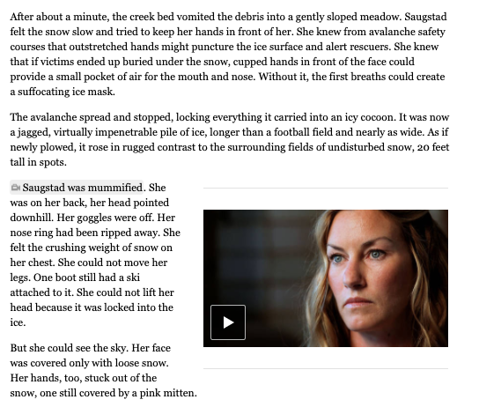
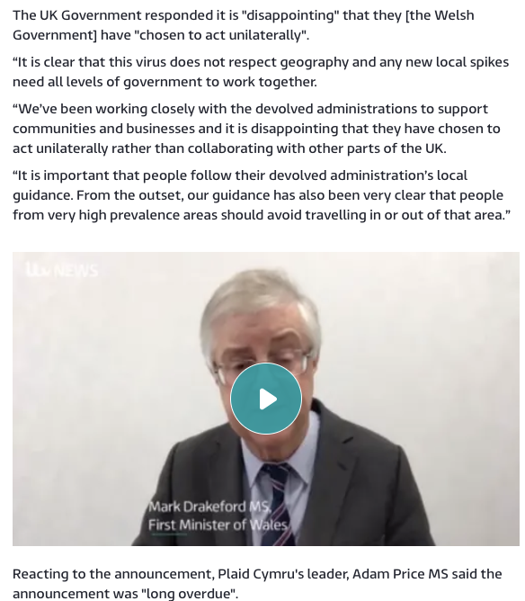
Adding to the story:
https://www.nytimes.com/projects/2012/snow-fall/index.html#/?part=tunnel-creek
https://www.itv.com/news/wales/2020-10-14/welsh-government-to-ban-people-travelling-into-wales-from-uk-covid-hotspots-following-pms-repeated-refusals

Slide 55
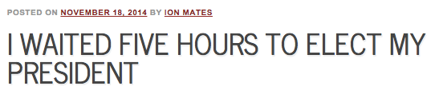

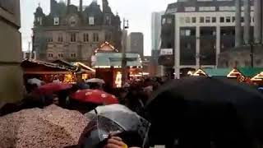
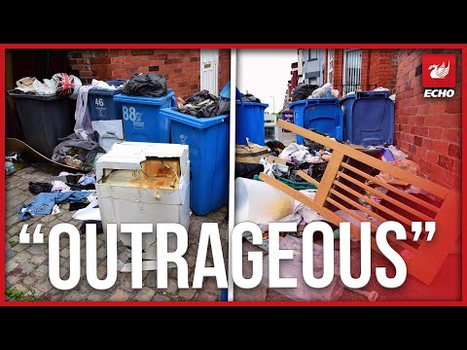
Distilling the story:
http://birminghameastside.com/romanian-presidential-elections-birmingham/
https://www.liverpoolecho.co.uk/news/liverpool-news/selfish-outrageous-mess-left-students-24340705

Slide 56
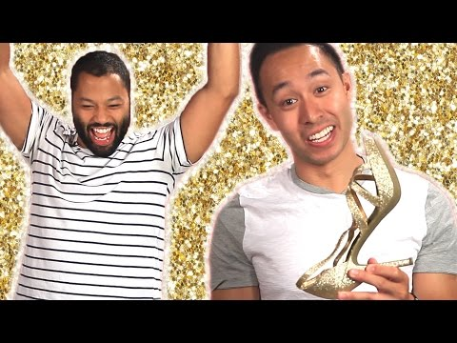
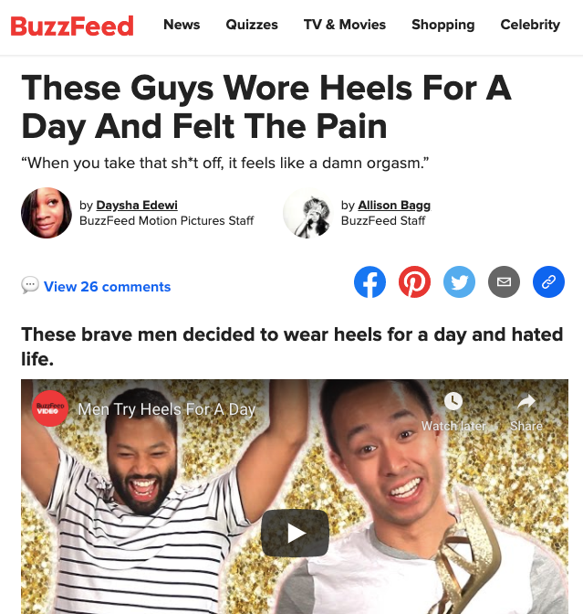
Telling the story:
https://www.youtube.com/watch?v=lPW2JUj8teM
https://www.buzzfeed.com/dayshavedewi/these-men-wore-heels-for-a-day-and-hated-life

Slide 57
Using a CTA
(Call To Action)

Slide 58
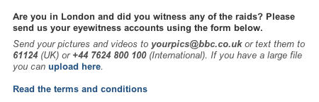
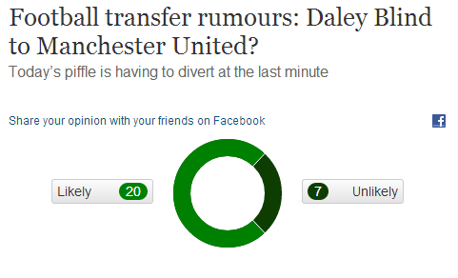
http://onlinejournalismblog.com/2014/08/07/transfer-rumours-robot-journalism-guardian-poll-before-the-article/

Slide 59


Slide 60
Edit your story for interactivity.

Slide 61





Slide 63
Community & conversation
It’s not all about you

Slide 64
Where does the user go next? Where do you go next?
Hashtags where they can follow the conversation
CTA: “comment”, “join”, “subscribe”
Where can you engage with the community directly — before, during and after story production?

Slide 65
Key points:
Think BASIC: keep pars brief, make it scannable and interactive
Think SEO: is your story easy to find?
Use checklists: it’s much more efficient than trying to remember everything

Slide 66
Directed study
Read: ch4 Writing for the Web, from Bradshaw, Paul (2023) The Online Journalism Handbook
Put the techniques into practice in your project (including for video/audio: titles, description, show notes, blog and/or transcript)

Slide 67
Classes will be 10-1 from next week

Slide 68
Further reading.
8 common mistakes when writing for the web — and what to do about them
7 buttons you should be using in the WordPress edit view

Slide 69
Task
Edit the interview on Moodle (or a documentary transcript) for BASIC
Check it against the checklists in the readings

Slide 70
Bonus material

Slide 71
Editing… for SEO
Search Engine Optimisation

Slide 72
Identify what your story’s keywords are
Keywords are the words/phrases people are likely to use when searching for your sort of story
E.g. In an interview with a band, the band’s name is going to be a keyword.
“True crime” or the case title might be a keyword for a podcast or documentary

Slide 73
Make sure the keyword is used in key positions
Titles should contain the keyword(s) — puns aren’t great for SEO
The first line/intro should too.
Subheadings should be optimised for each section

Slide 74


Slide 75
Edit code, not just content
Headings should use proper heading tags <h1>, etc. (not just bold)
Images should have ALT tags and captions with relevant keywords
Edit the URL/title of the page if you can

Slide 76
For SEO I made sure my headline and intro included keywords, and subheadings used heading tags (Bradshaw 2023)
Bibliography entry:
Bradshaw, Paul (2023) Online Journalism Handbook, Routledge
How you might reference this:

Slide 77
Behaviour is the biggest factor
How many pages link to your story? (And how highly ranked are they?)
What words do they use when linking?
How many social media shares?
How long has your site existed, how frequently does it publish, and how highly ranked is it?
How many people click on links to your story — and how long do they stay?

Slide 78
The most important SEO technique is to write unique content that people will want to read and share.
It also helps if you do that regularly and persistently enough to build a reputation.

Slide 79
I brainstormed ideas for video I could include in the story (Appendix E), using the five types of online video identified by Alfred Hermida (in Bradshaw 2023)
Bibliography entry:
Bradshaw, Paul (2023) Online Journalism Handbook, Routledge
How you might reference this:

